Slide 1
Midterm Exam

Slide 2
Keys are explicitly scored in? ( A )
DST
Path to a specific node is a ‘prefix’ of the binary representation of a key
Keys should be stored in nodes, in order to make ‘equal’ comparison
Keys can be stored in any of the nodes
RST, DLB, R-way Trie
Keys are parsed along the path to the leaf nodes
Keys can only be stored in leaves

Slide 3

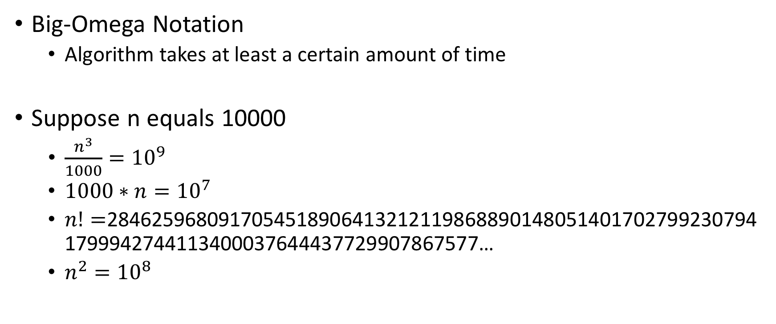
Not $Ω\left(n^{2}\right)$? ( B )
Big-Omega Notation
Algorithm takes at least a certain amount of time
Suppose n equals 10000
$\frac{n^{3}}{1000}={10}^{9}$
$1000∗n={10}^{7}$
$n!=$28462596809170545189064132121198688901480514017027992307941799942744113400037644437729907867577…
$n^{2}={10}^{8}$

Slide 4
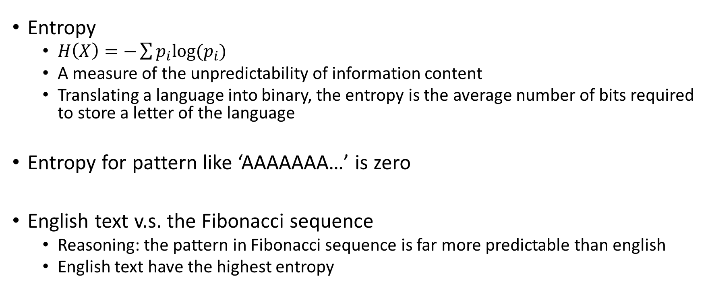
Highest entropy? ( A )
Entropy
$H\left(X\right)=−\sum{p_{i}log⁡(p_{i})}$
A measure of the unpredictability of information content
Translating a language into binary, the entropy is the average number of bits required to store a letter of the language
Entropy for pattern like ‘AAAAAAA…’ is zero
English text v.s. the Fibonacci sequence
Reasoning: the pattern in Fibonacci sequence is far more predictable than english
English text have the highest entropy

Slide 5
Algorithm? ( A )
A step-by-step procedure for solving a problem or accomplishing some end

Slide 6
Goal of double hashing? ( C )
Double hashing
After a collision, instead of attempting to place the key x in i+1 mod m, look at i+h2(x) mod m
Linear Probing
Attempt to insert the key at index i +1
Then i + 2
…
Goal
To cut down the number of probes needed to insert

Slide 7
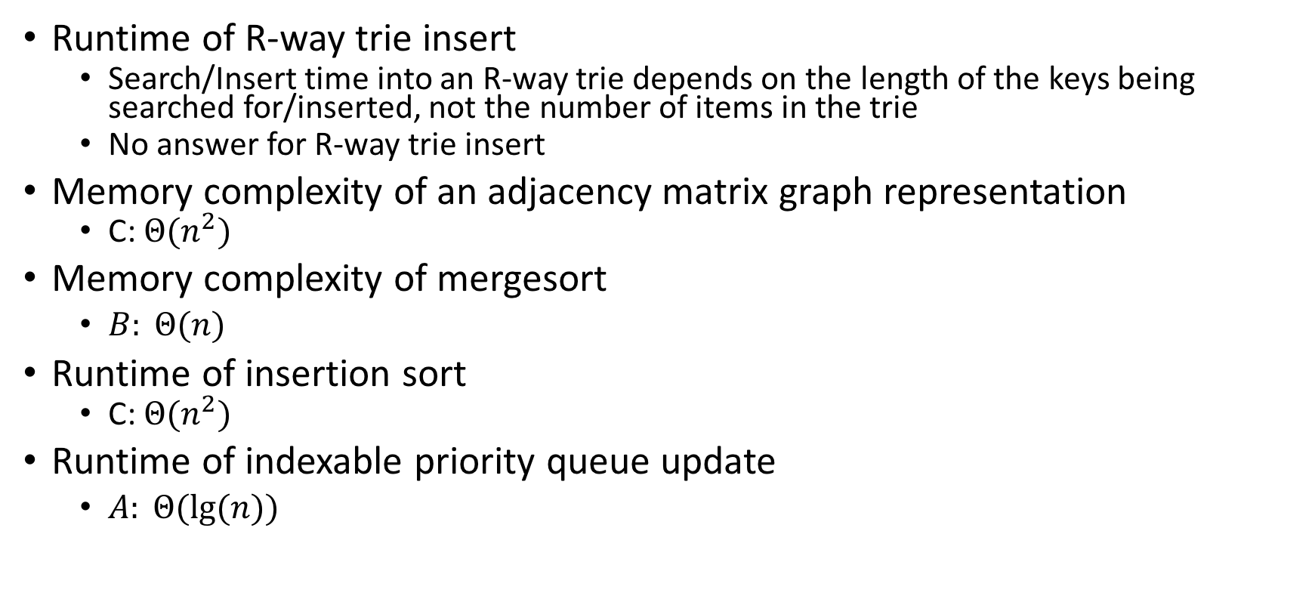
Big theta notation
Runtime of R-way trie insert
Search/Insert time into an R-way trie depends on the length of the keys being searched for/inserted, not the number of items in the trie
No answer for R-way trie insert
Memory complexity of an adjacency matrix graph representation
C: $Θ(n^{2})$
Memory complexity of mergesort
$B: Θ(n)$
Runtime of insertion sort
C: $Θ(n^{2})$
Runtime of indexable priority queue update
$A: Θ(lg⁡(n))$

Slide 8
Good hash function
Can we reduce the number of collisions?
Using a good hash function is a start
Utilize the entire key
Exploit differences between keys
Uniform distribution of hash values should be produced

Slide 9
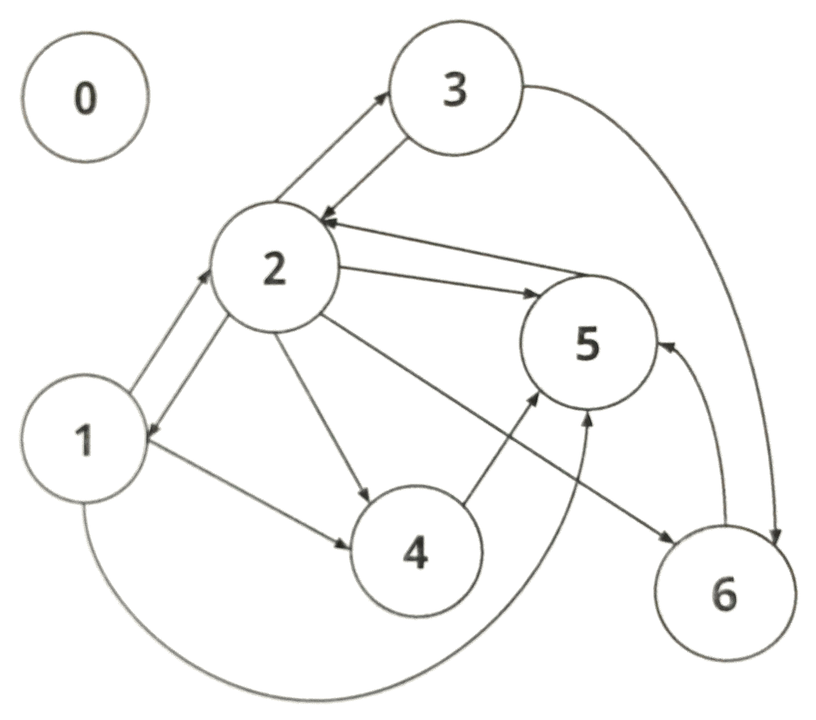
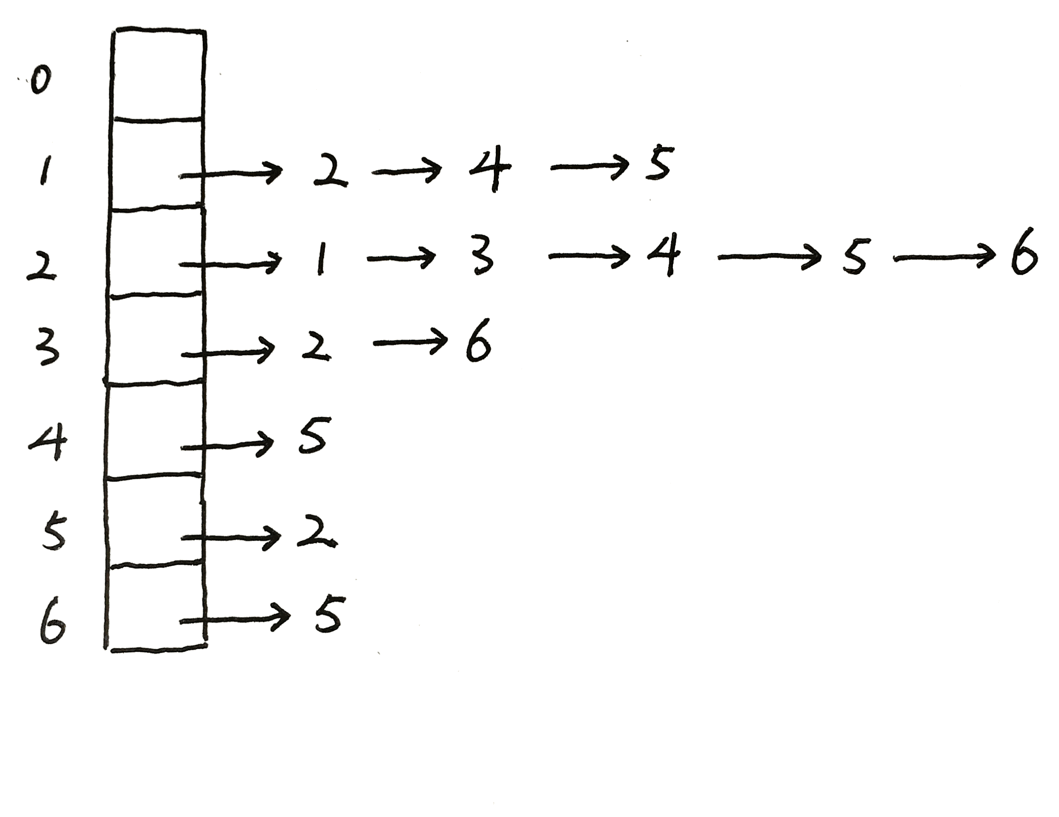
Adjacency list

Slide 10
Min heap
Insert the following values.
112, 5, 3, 12, 14, 1, 7

Slide 11
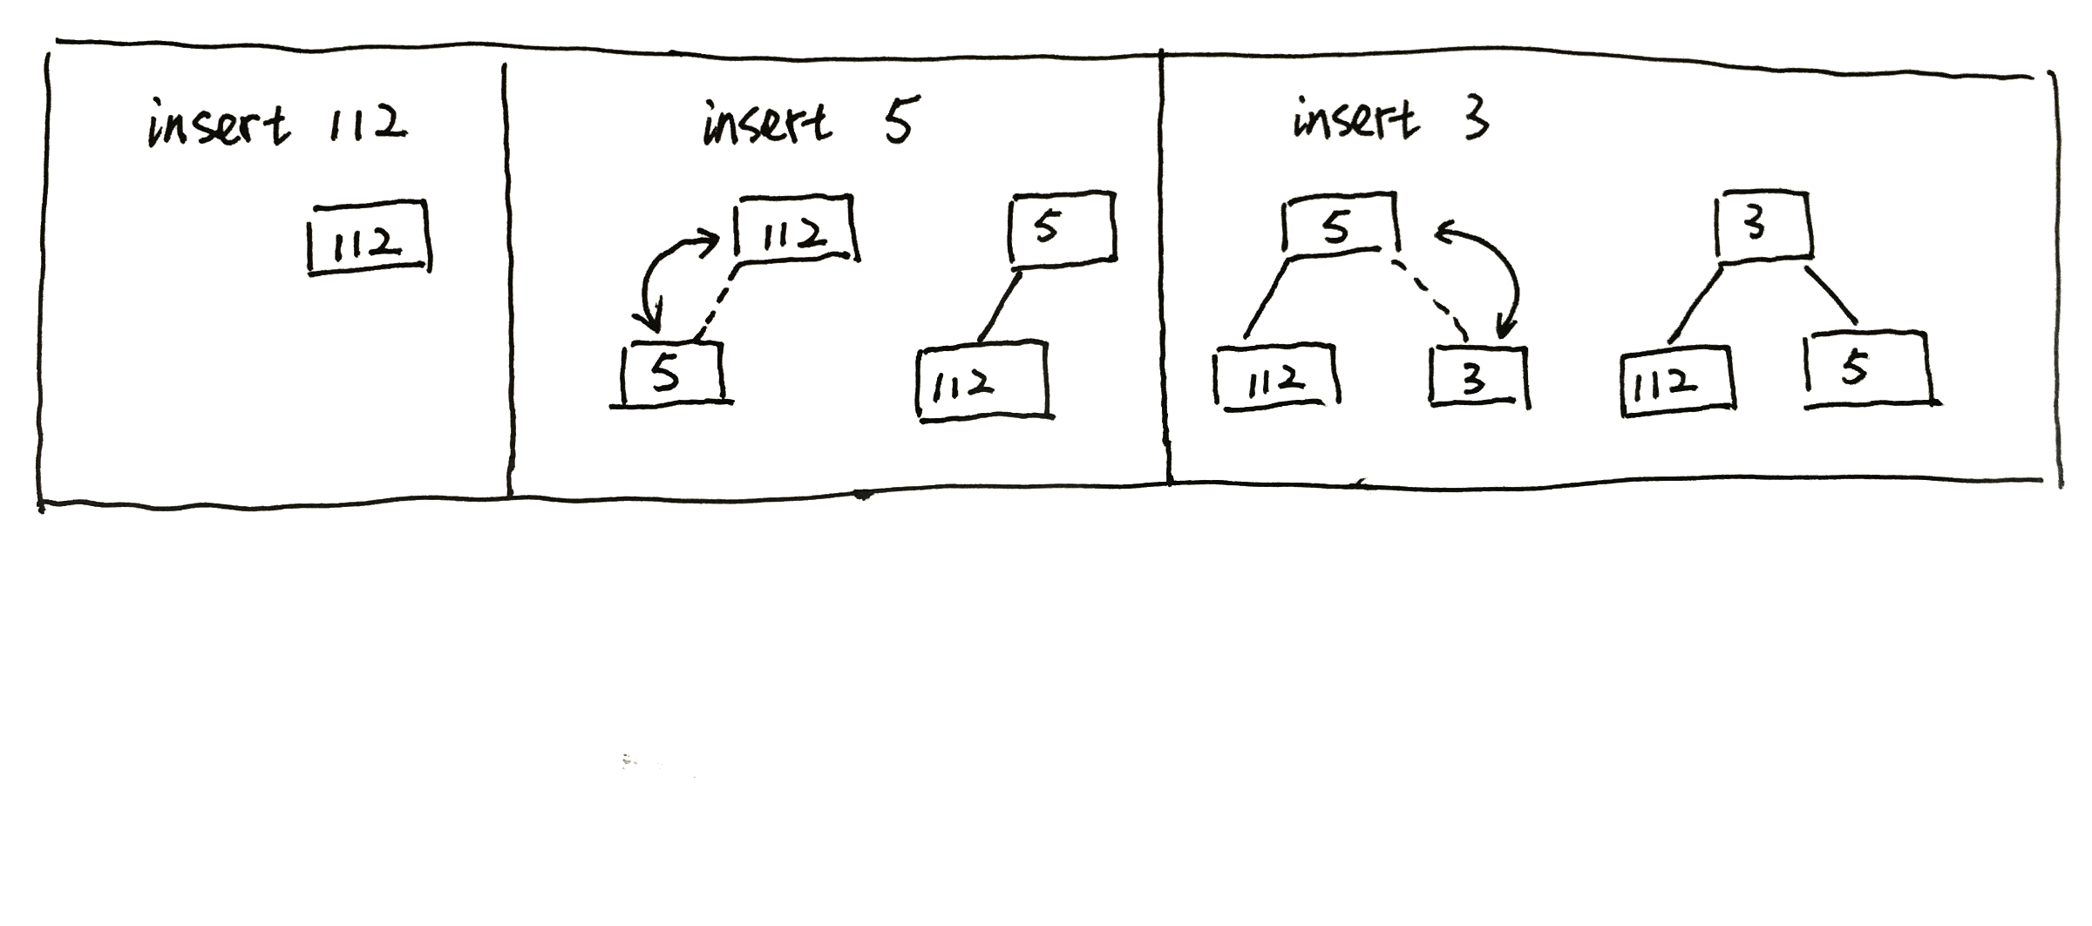
Min heap

Slide 12
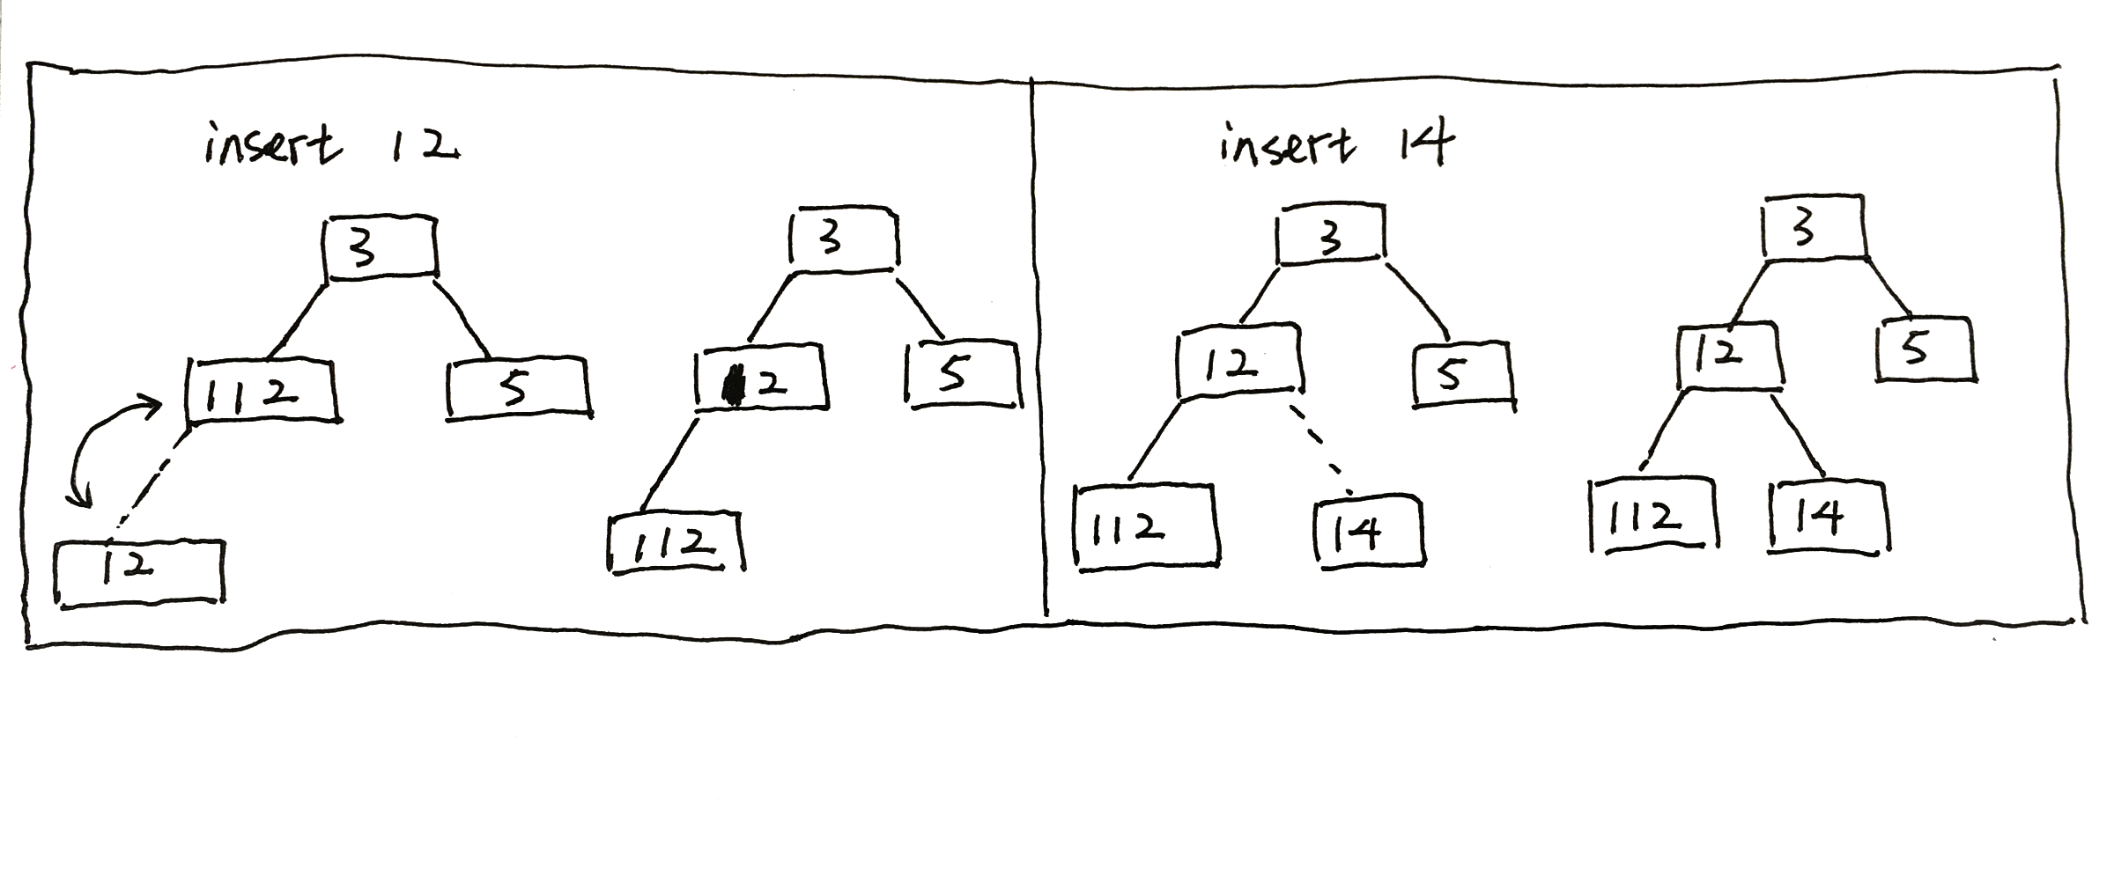
Min heap

Slide 13
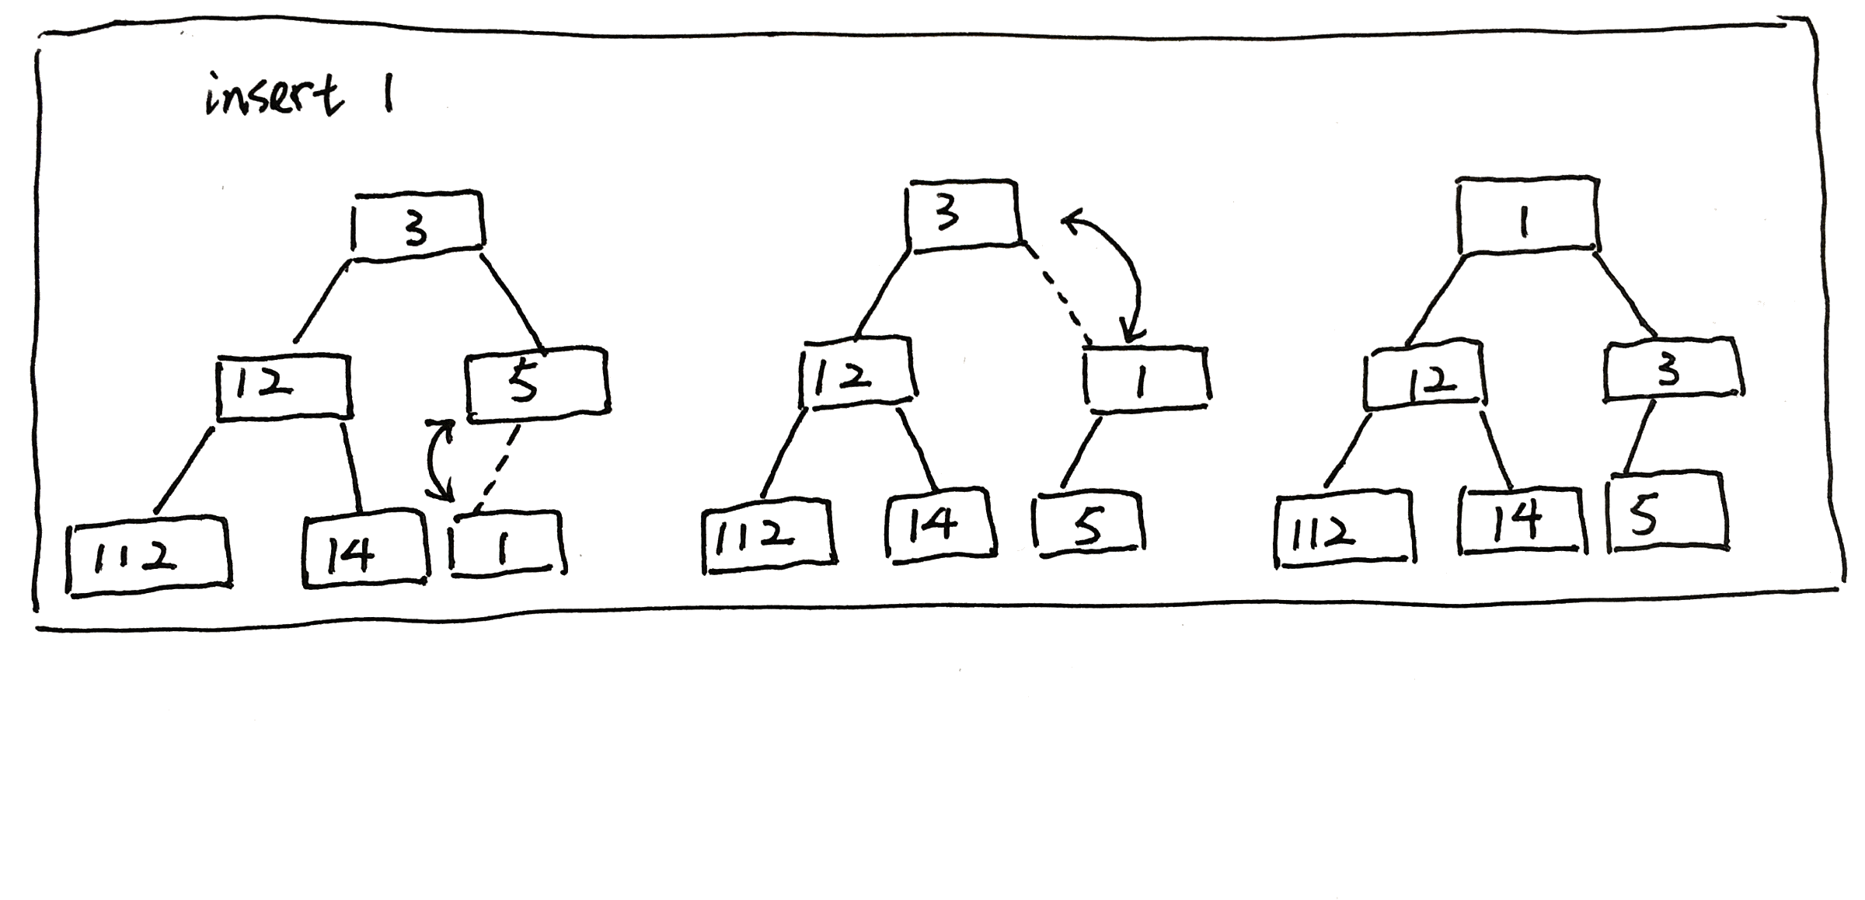
Min heap

Slide 14
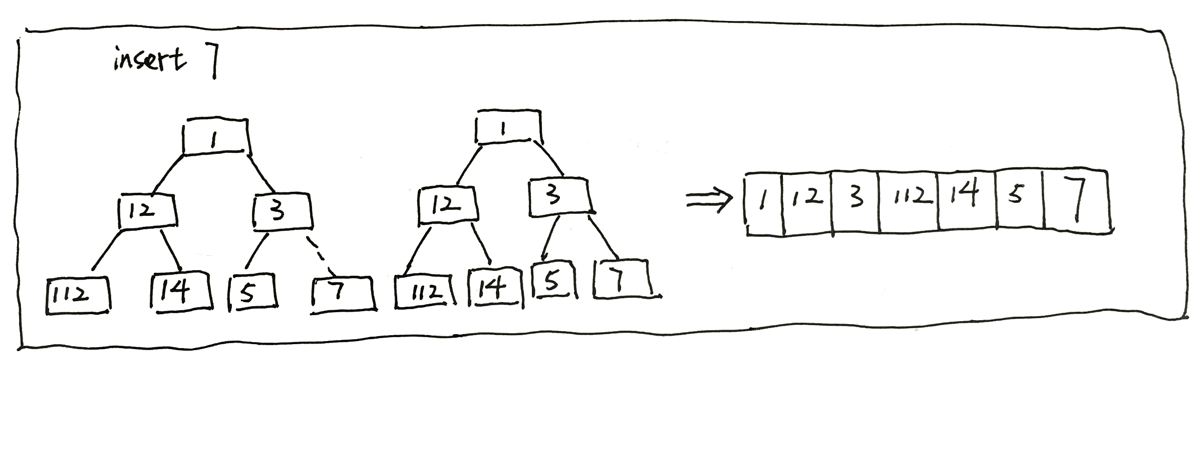
Min heap

Slide 15
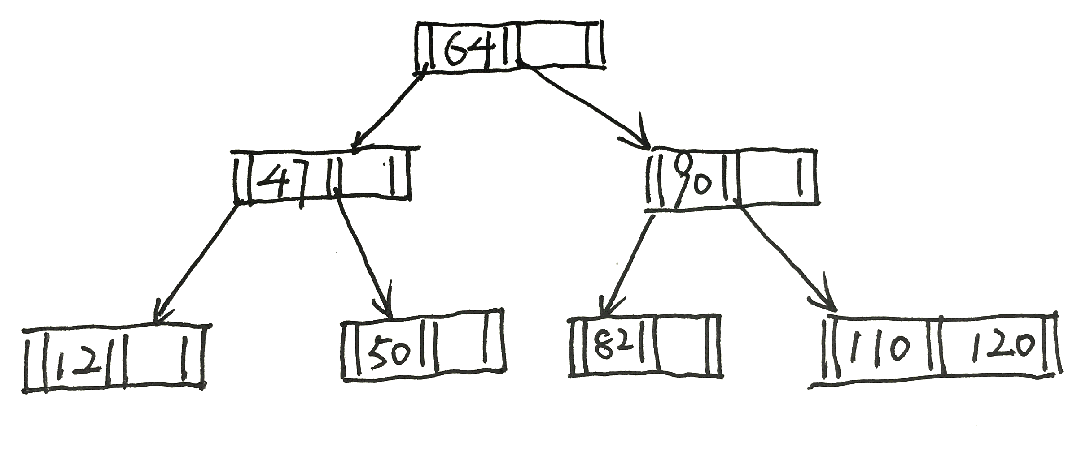
B-tree

Slide 16
B-tree
Find and delete the value
If the value is not in a leaf node, you need to find a replacement…
Rebalance the tree
Is there a sibling node with more than minimum keys?
If so rotate right/left accordingly
If not, need to merge with the left or right sibling

Slide 17
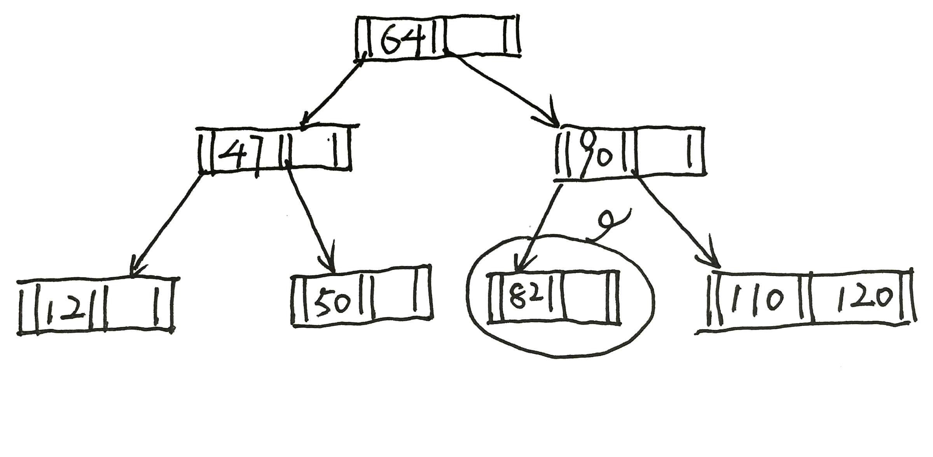
B-tree (remove 82)
Find and delete the value

Slide 18
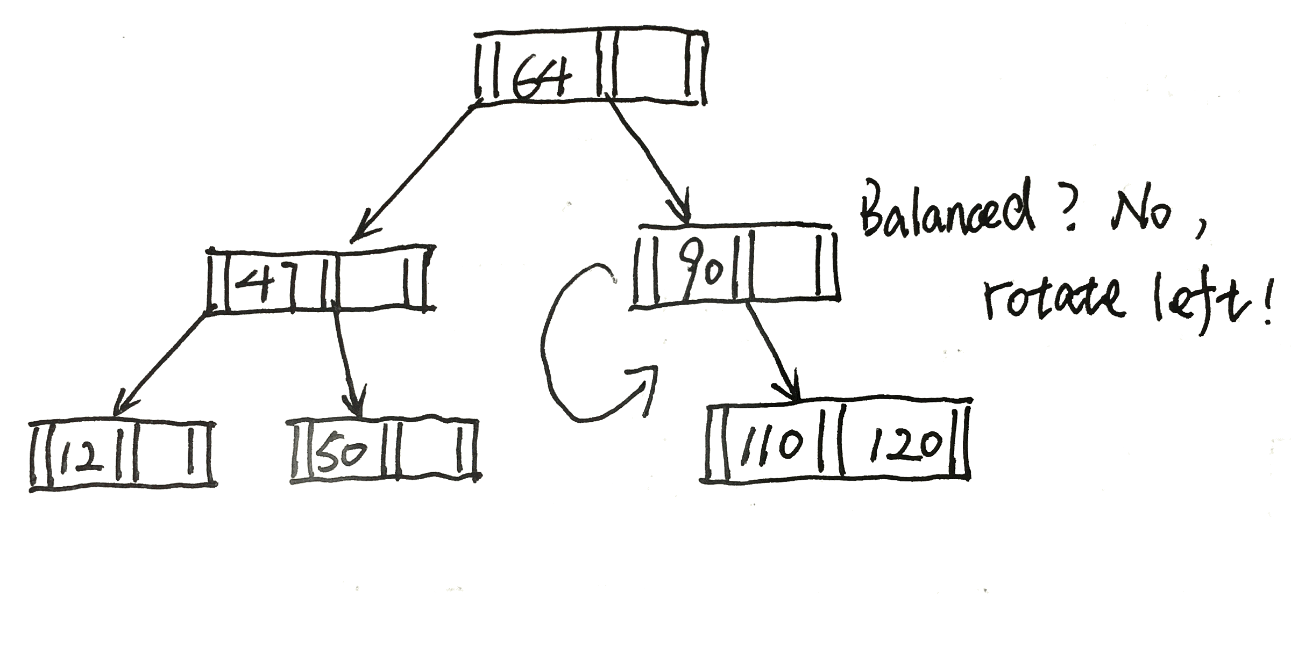
B-tree (remove 82)
Right sibling node with more than minimum keys
Rotate left accordingly

Slide 19
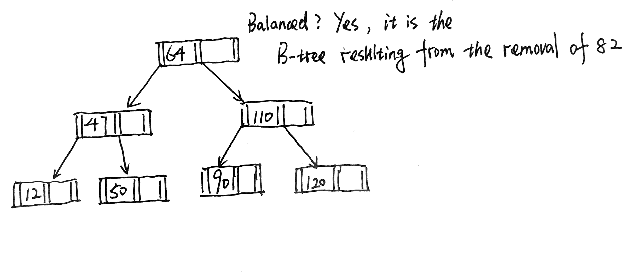
B-tree (remove 82)

Slide 20
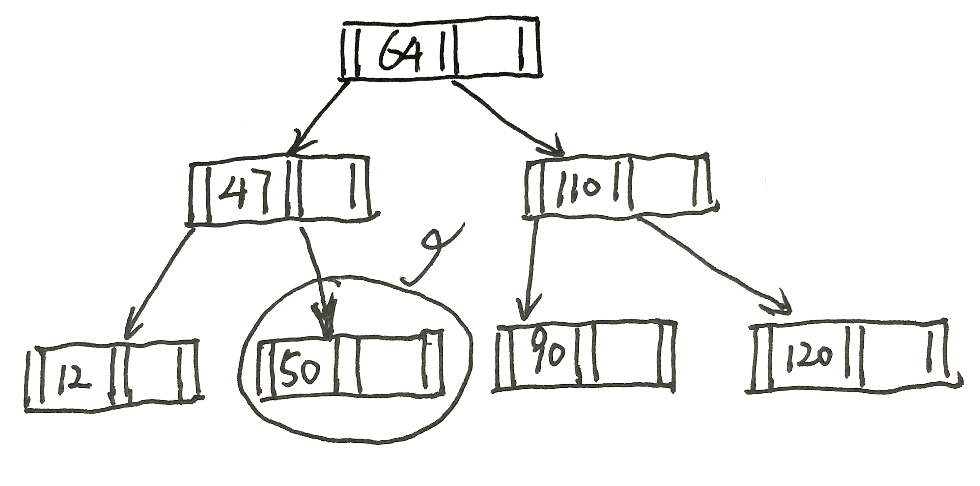
B-tree (remove 50)
Find and delete the value

Slide 21
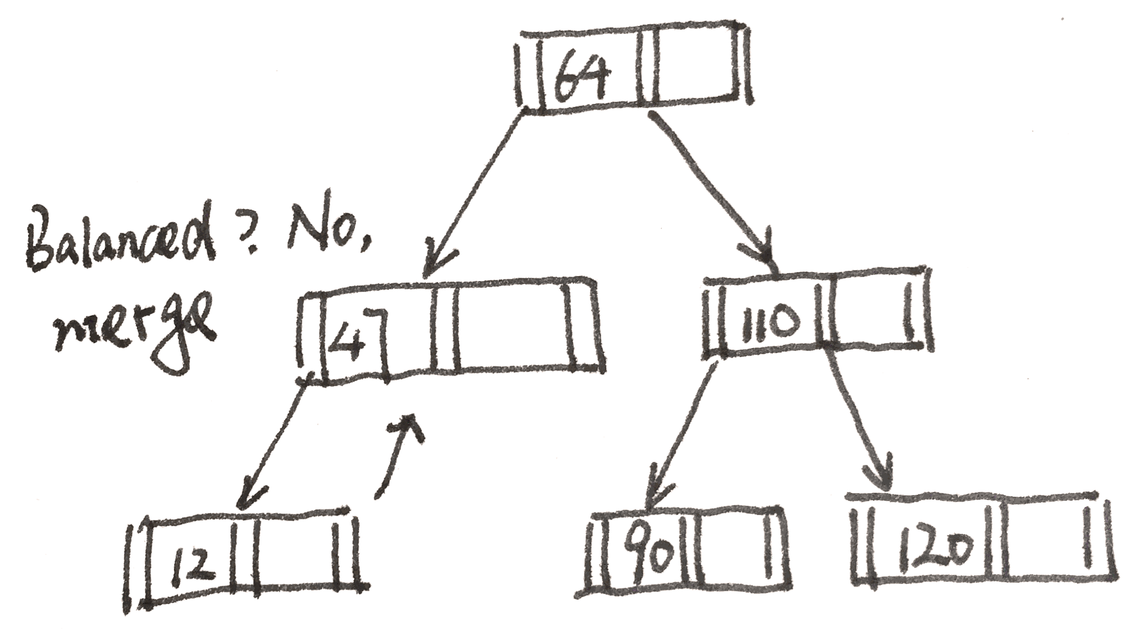
B-tree (remove 50)
No sibling node with more than minimum keys
Merge with the left or right sibling

Slide 22
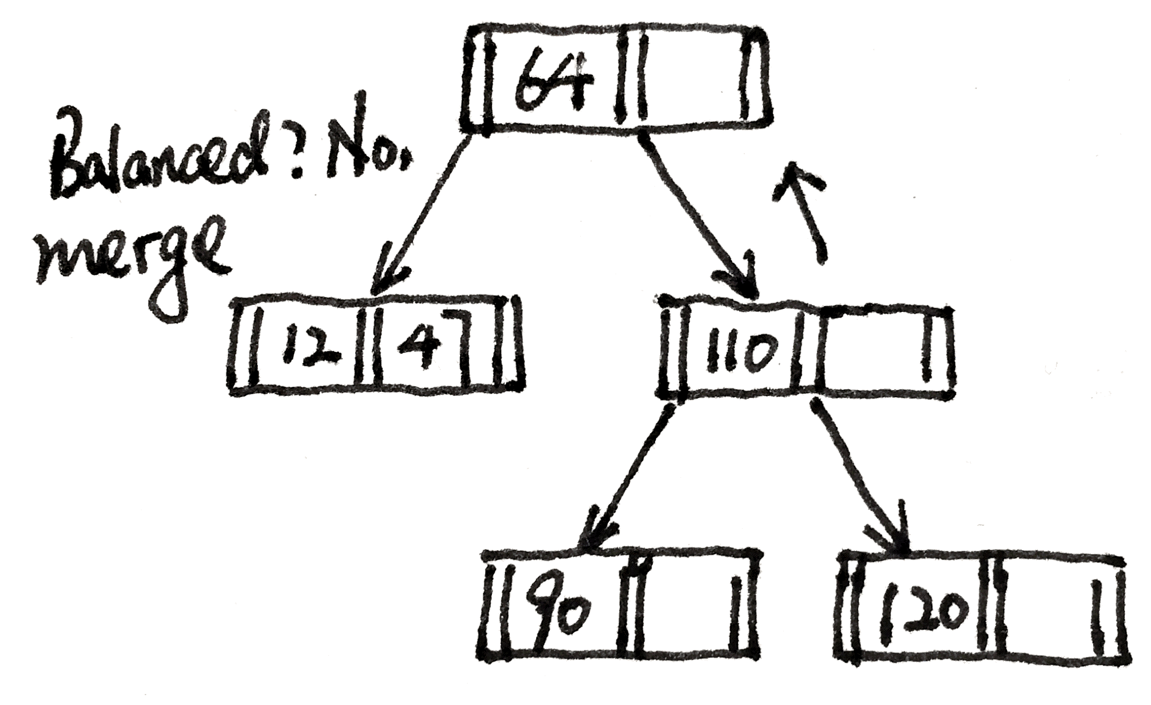
B-tree (remove 50)
No sibling node with more than minimum keys
Merge with the left or right sibling

Slide 23
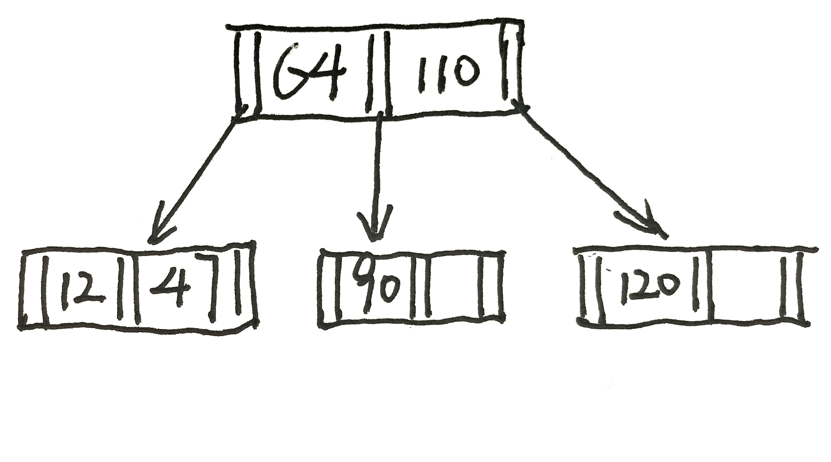
B-tree (remove 50)

Slide 24
B-tree
Order 3
How to define the order?
Max(numberOfChildren)

Slide 25
Radix sort
Original array
247, 85, 87, 45, 210, 40, 95, 217, 80, 110
Sorted by digit
210, 40, 80, 110, 85, 45, 95, 247, 87, 217
Sorted by tens
210, 110, 217, 40, 45, 247, 80, 85, 87, 95
Sorted by Hundreds digit
40, 45, 80, 85, 87, 95, 110, 210, 217, 247
Result
40, 45, 80, 85, 87, 95, 110, 210, 217, 247

Slide 26
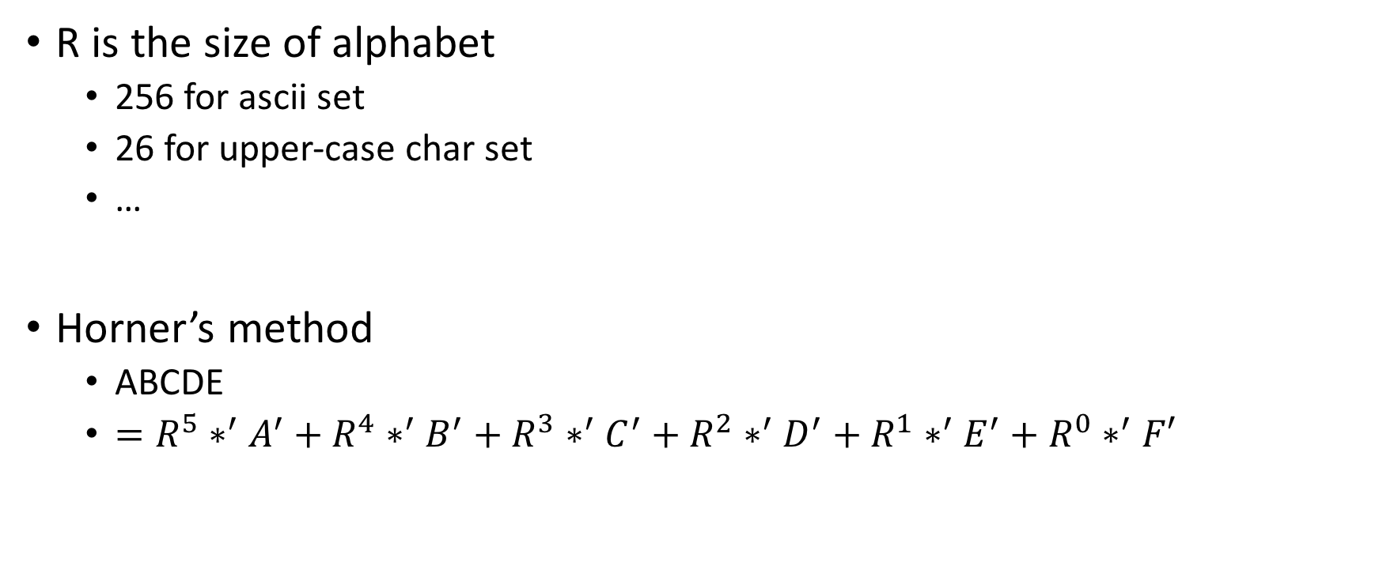
Horner’s method
R is the size of alphabet
256 for ascii set
26 for upper-case char set
…
Horner’s method
ABCDE
$=R^{5}∗^{′}A^{′}+R^{4}∗^{′}B^{′}+R^{3}∗^{′}C^{′}+R^{2}∗^{′}D^{′}+R^{1}∗^{′}E^{′}+R^{0}∗^{′}F′$

Slide 27
Frequency of execution of each statement
Determined by program and input
What is the program like?
What is the input of the program?

Slide 28
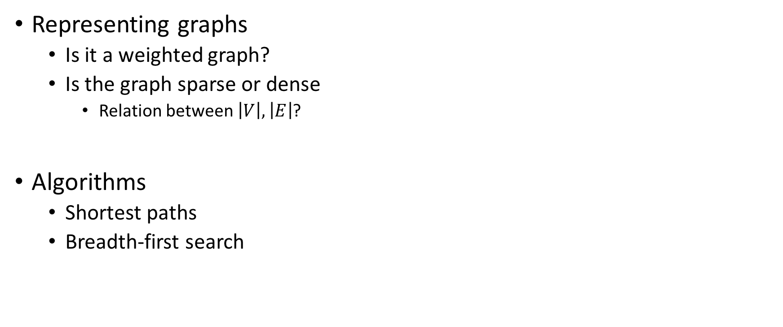
Mapping application
Representing graphs
Is it a weighted graph?
Is the graph sparse or dense
Relation between $\left|V\right|,\left|E\right|$?
Algorithms
Shortest paths
Breadth-first search

Slide 29
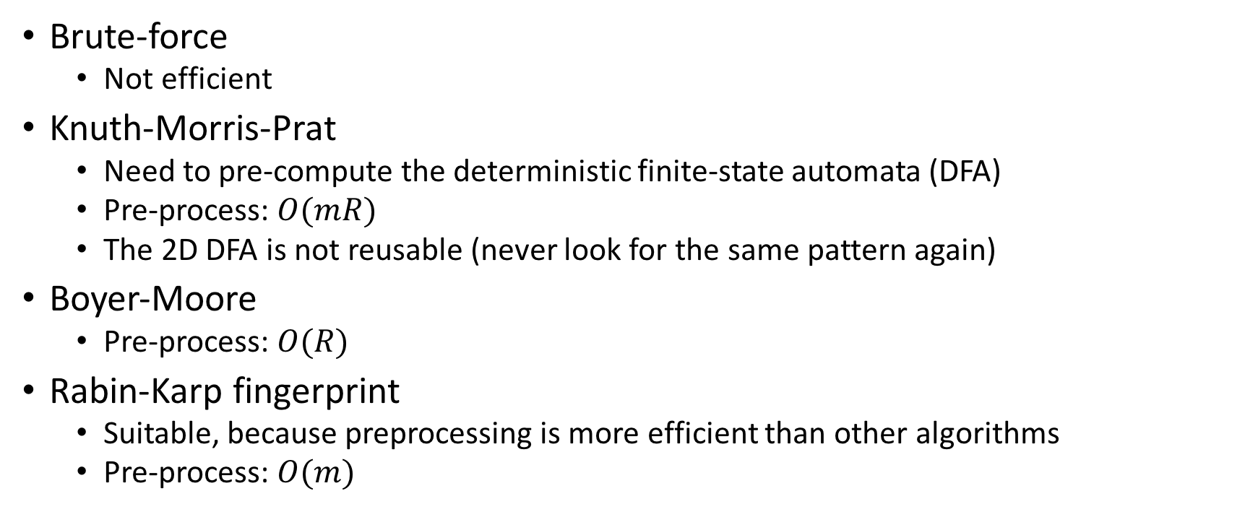
String pattern matching
Brute-force
Not efficient
Knuth-Morris-Prat
Need to pre-compute the deterministic finite-state automata (DFA)
Pre-process: $O(mR)$
The 2D DFA is not reusable (never look for the same pattern again)
Boyer-Moore
Pre-process: $O(R)$
Rabin-Karp fingerprint
Suitable, because preprocessing is more efficient than other algorithms
Pre-process: $O(m)$

Slide 30
Good passwords
R-way trie is a better data structure
Because of the density of prefixes
If we are using the R-way trie, most of the branches will be populated in practice

